Slide 1

Chapter 4: Computing Platform
Embedded System Design

Slide 2
Microcontrollers
Microprocessor
CPU (on single chip)
Microcontroller
CPU + Timers + I/O (+RAM) (+ROM)
Reduced chip count for board design
Embedded system
Today’s Technology:
Surface Mount Device (SMD)
Ball Grid Array (BGA)

Slide 3
User Interface
Analog i/p
Analog Front End
D/A,
Isolation..
Analog o/p
User Interface Modules
Digital i/p
Digital i/p Ports
Digital o/p
Digital o/p Ports
interrupts
Support:
Timers
Watchdog
INPUTS
OUTPUTS
CPU
Comms:
ASC, SSC, USB, IIC,
IrDA, etc.
Data Bus
Address Bus
Data Memory
Program Memory
Links to Other Systems
3 of

Slide 4
Two Memory Architectures
Princeton
Fewer memory wires
Harvard
Simultaneous program and data memory access
Processor
Processor
Program memory
Data memory
Memory
(program and data)
Harvard
Princeton

Slide 5
A simple bus
Wires:
Uni-directional or bi-directional
One line may represent multiple wires
Bus
Set of wires with a single function
Address bus, data bus
Or, entire collection of wires
Address, data and control
Associated protocol: rules for communication
rd'/wr
Processor
Memory
enable
addr[0-11]
data[0-7]
bus
bus structure

Slide 6
Ports
Processor
rd'/wr
Memory
port
enable
addr[0-11]
data[0-7]
bus
Conducting device on periphery
Connects bus to processor or memory
Often referred to as a pin
Actual pins on periphery of IC package that plug into socket on printed-circuit board
Sometimes metallic balls instead of pins
Today, metal “pads” connecting processors and memories within single IC
Single wire or set of wires with single function
E.g., 12-wire address port

Slide 7
Timing Diagrams
Most common method for describing a communication protocol
Time proceeds to the right on x-axis
Control signal: low or high
May be active low (e.g., go’, /go, or go_L)
Use terms assert (active) and deassert
Asserting go’ means go=0
Data signal: not valid or valid
Protocol may have subprotocols
Called bus cycle, e.g., read and write
Each may be several clock cycles
Read example
rd’/wr set low,address placed on addr for at least t_{setup} time before enable asserted, enable triggers memory to place data on data wires by time t_{read}
rd'/wr
enable
addr
data
t_{setup}
t_{read}
read protocol
rd'/wr
enable
addr
data
t_{setup}
t_{write}
write protocol

Slide 8
Memory hierarchy
Want inexpensive, fast memory
Main memory
Large, inexpensive, slow memory stores entire program and data
Cache
Small, expensive, fast memory stores copy of likely accessed parts of larger memory
Can be multiple levels of cache
Processor
Registers
Cache
Main memory
Disk
Tape

Slide 9
Cache
Usually designed with SRAM
faster but more expensive than DRAM
Usually on same chip as processor
space limited, so much smaller than off-chip main memory
faster access ( 1 cycle vs. several cycles for main memory)
Cache operation:
Request for main memory access (read or write)
First, check cache for copy
cache hit
copy is in cache, quick access
cache miss
copy not in cache, read address and possibly its neighbors into cache
Several cache design choices
cache mapping, replacement policies, and write techniques

Slide 10
Cache mapping
Far fewer number of available cache addresses
Are address’ contents in cache?
Cache mapping used to assign main memory address to cache address and determine hit or miss
Three basic techniques:
Direct mapping
Fully associative mapping
Set-associative mapping
Caches partitioned into indivisible blocks or lines of adjacent memory addresses
usually 4 or 8 addresses per line

Slide 11
Cache-replacement policy
Technique for choosing which block to replace
when fully associative cache is full
when set-associative cache’s line is full
Direct mapped cache has no choice
Random
replace block chosen at random
LRU: least-recently used
replace block not accessed for longest time
FIFO: first-in-first-out
push block onto queue when accessed
choose block to replace by popping queue

Slide 12
Cache write techniques
When written, data cache must update main memory
Write-through
write to main memory whenever cache is written to
easiest to implement
processor must wait for slower main memory write
potential for unnecessary writes
Write-back
main memory only written when “dirty” block replaced
extra dirty bit for each block set when cache block written to
reduces number of slow main memory writes

Slide 13
Memory: basic concepts
Stores large number of bits
m x n: m words of n bits each
k = Log2(m) address input signals
or m = 2^k words
e.g., 4,096 x 8 memory:
32,768 bits
12 address input signals
8 input/output data signals
Memory access
r/w: selects read or write
enable: read or write only when asserted
multiport: multiple accesses to different locations simultaneously
m × n memory
…
m words
…
n bits per word
memory external view
r/w
2^{k} × n read and write memory
enable
A₀
…
A_{k-1}
…
Q_{n-1}
Q₀

Slide 14
Write ability/ storage permanence
Traditional ROM/RAM distinctions
ROM
read only, bits stored without power
RAM
read and write, lose stored bits without power
Traditional distinctions blurred
Advanced ROMs can be written to
e.g., EEPROM
Advanced RAMs can hold bits without power
e.g., NVRAM
Write ability
Manner and speed a memory can be written
Storage permanence
ability of memory to hold stored bits after they are written
permanence
Storage
Mask-programmed ROM
Ideal memory
Life of
OTP ROM
product
Tens of
EPROM
EEPROM
FLASH
years
Battery
Nonvolatile
NVRAM
life (10
years)
In-system
SRAM/DRAM
programmable
Near
Write
zero
ability
During
External
External
External
External
In-system, fast
fabrication
programmer,
programmer,
programmer
programmer
writes,
only
one time only
1,000s
OR in-system,
OR in-system,
unlimited
of cycles
1,000s
block-oriented
cycles
of cycles
writes, 1,000s
of cycles
Write ability and storage permanence of memories,
showing relative degrees along each axis (not to scale).

Slide 15
Write ability
Ranges of write ability
High end
processor writes to memory simply and quickly
e.g., RAM
Middle range
processor writes to memory, but slower
e.g., FLASH, EEPROM
Lower range
special equipment, “programmer”, must be used to write to memory
e.g., EPROM, OTP ROM
Low end
bits stored only during fabrication
e.g., Mask-programmed ROM
In-system programmable memory
Can be written to by a processor in the embedded system using the memory
Memories in high end and middle range of write ability

Slide 16
Storage permanence
Range of storage permanence
High end
essentially never loses bits
e.g., mask-programmed ROM
Middle range
holds bits days, months, or years after memory’s power source turned off
e.g., NVRAM
Lower range
holds bits as long as power supplied to memory
e.g., SRAM
Low end
begins to lose bits almost immediately after written
e.g., DRAM
Nonvolatile memory
Holds bits after power is no longer supplied
High end and middle range of storage permanence

Slide 17
ROM: “Read-Only” Memory
Nonvolatile memory
Can be read from but not written to, by a processor in an embedded system
Traditionally written to, “programmed”, before inserting to embedded system
Uses
Store software program for general-purpose processor
program instructions can be one or more ROM words
Store constant data needed by system
Implement combinational circuit
External view
enable
2^{k} × n ROM
A₀
A_{k-1}
…
…
Q_{n-1}
Q₀

Slide 18
Example: 8 x 4 ROM
Horizontal lines = words
Vertical lines = data
Lines connected only at circles
Decoder sets word 2’s line to 1 if address input is 010
Data lines Q3 and Q1 are set to 1 because there is a “programmed” connection with word 2’s line
Word 2 is not connected with data lines Q2 and Q0
Output is 1010
Internal view
8 × 4 ROM
3×8 decoder
word 0
enable
word 1
word 2
A₀
word line
A₁
A₂
data line
programmable connection
wired-OR
Q₃
Q₂
Q₁
Q₀

Slide 19
Implementing combinational function
Any combinational circuit of n functions of same k variables can be done with 2^k x n ROM
Truth table
Inputs (address) Outputs
a b c y z
0 0 0 0 0
0 0 1 0 1
0 1 0 0 1
0 1 1 1 0
1 0 0 1 0
1 0 1 1 1
1 1 0 1 1
1 1 1 1 1
8×2 ROM
0 0
0 1
0 1
1 0
1 0
1 1
1 1
1 1
word 0
word 1
enable
c
b
word 7
a
y
z

Slide 20
Mask-programmed ROM
Connections “programmed” at fabrication
set of masks
Lowest write ability
only once
Highest storage permanence
bits never change unless damaged
Typically used for final design of high-volume systems
spread out NRE cost for a low unit cost

Slide 21
OTP ROM: One-time programmable ROM
Connections “programmed” after manufacture by user
user provides file of desired contents of ROM
file input to machine called ROM programmer
each programmable connection is a fuse
ROM programmer blows fuses where connections should not exist
Very low write ability
typically written only once and requires ROM programmer device
Very high storage permanence
bits don’t change unless reconnected to programmer and more fuses blown
Commonly used in final products
cheaper, harder to inadvertently modify

Slide 22
EPROM: Erasable programmable ROM
Programmable component is a MOS transistor
Transistor has “floating” gate surrounded by an insulator
(a) Negative charges form a channel between source and drain storing a logic 1
(b) Large positive voltage at gate causes negative charges to move out of channel and get trapped in floating gate storing a logic 0
(c) (Erase) Shining UV rays on surface of floating-gate causes negative charges to return to channel from floating gate restoring the logic 1
(d) An EPROM package showing quartz window through which UV light can pass
Better write ability
can be erased and reprogrammed thousands of times
Reduced storage permanence
program lasts about 10 years but is susceptible to radiation and electric noise
Typically used during design development
floating gate
0V
source
drain
(a)
+15V
(b)
source
drain
5-30 min
(c)
source
drain
(d)
.

Slide 23
EEPROM: Electrically erasable programmable ROM
Programmed and erased electronically
typically by using higher than normal voltage
can program and erase individual words
Better write ability
can be in-system programmable with built-in circuit to provide higher than normal voltage
built-in memory controller commonly used to hide details from memory user
writes very slow due to erasing and programming
“busy” pin indicates to processor EEPROM still writing
can be erased and programmed tens of thousands of times
Similar storage permanence to EPROM (about 10 years)
Far more convenient than EPROMs, but more expensive

Slide 24
Flash Memory
Extension of EEPROM
Same floating gate principle
Same write ability and storage permanence
Fast erase
Large blocks of memory erased at once, rather than one word at a time
Blocks typically several thousand bytes large
Writes to single words may be slower
Entire block must be read, word updated, then entire block written back
Used with embedded systems storing large data items in nonvolatile memory
e.g., digital cameras, TV set-top boxes, cell phones

Slide 25
RAM: “Random-access” memory
Typically volatile memory
bits are not held without power supply
Read and written to easily by embedded system during execution
Internal structure more complex than ROM
a word consists of several memory cells, each storing 1 bit
each input and output data line connects to each cell in its column
rd/wr connected to every cell
when row is enabled by decoder, each cell has logic that stores input data bit when rd/wr indicates write or outputs stored bit when rd/wr indicates read
external view
r/w
2^{k} × n read and write memory
enable
A₀
…
A_{k-1}
…
Q_{n-1}
Q₀
internal view
I₃
I₂
I₁
I₀
4×4 RAM
enable
2×4 decoder
A₀
A₁
Memory cell
rd/wr
To every cell
Q₃
Q₂
Q₁
Q₀

Slide 26
Basic types of RAM
SRAM: Static RAM
Memory cell uses flip-flop to store bit
Requires 6 transistors
Holds data as long as power supplied
DRAM: Dynamic RAM
Memory cell uses MOS transistor and capacitor to store bit
More compact than SRAM
“Refresh” required due to capacitor leak
word’s cells refreshed when read
Typical refresh rate 15.625 microsec.
Slower to access than SRAM
memory cell internals
SRAM
Data'
Data
W
DRAM
Data
W

Slide 27
Ram variations
PSRAM: Pseudo-static RAM
DRAM with built-in memory refresh controller
Popular low-cost high-density alternative to SRAM
NVRAM: Nonvolatile RAM
Holds data after external power removed
Battery-backed RAM
SRAM with own permanently connected battery
writes as fast as reads
no limit on number of writes unlike nonvolatile ROM-based memory
SRAM with EEPROM or flash
stores complete RAM contents on EEPROM or flash before power turned off

Slide 28
Example: HM6264 & 27C256 RAM/ROM devices
Low-cost low-capacity memory devices
Commonly used in 8-bit microcontroller-based embedded systems
First two numeric digits indicate device type
RAM: 62
ROM: 27
Subsequent digits indicate capacity in kilobits
11-13, 15-19
data<7…0>
11-13, 15-19
data<7…0>
2,23,21,24,
addr<15...0>
27,26,2,23,21,
addr<15...0>
25, 3-10
24,25, 3-10
22
/OE
22
/OE
27
/WE
20
/CS
20
/CS1
26
CS2
HM6264
block diagrams
27C256
Device Access Time (ns) Standby Pwr. (mW) Active Pwr. (mW) Vcc Voltage (V)
HM6264 85-100 .01 15 5
27C256 90 .5 100 5
device characteristics
Read operation
Write operation
data
data
addr
addr
OE
WE
/CS1
/CS1
CS2
CS2
timing diagrams

Slide 29
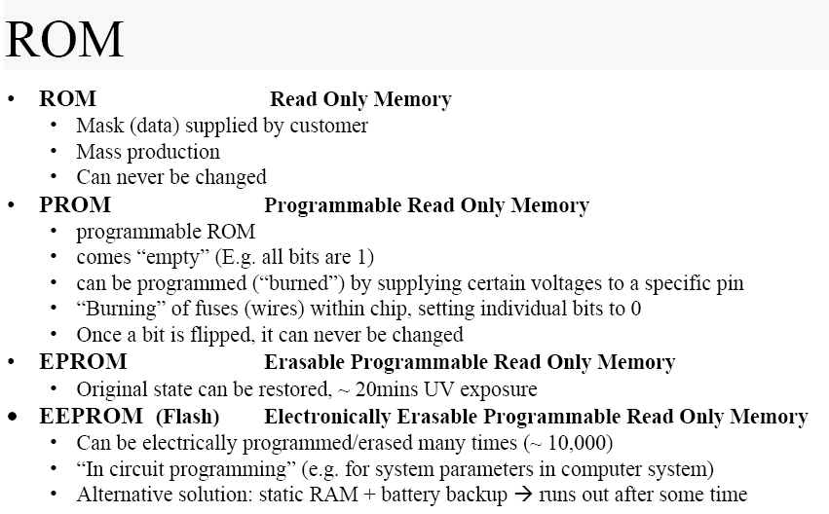

Slide 30
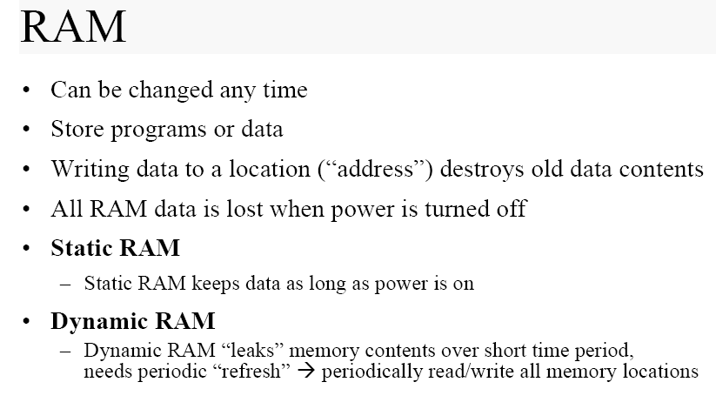

Slide 31
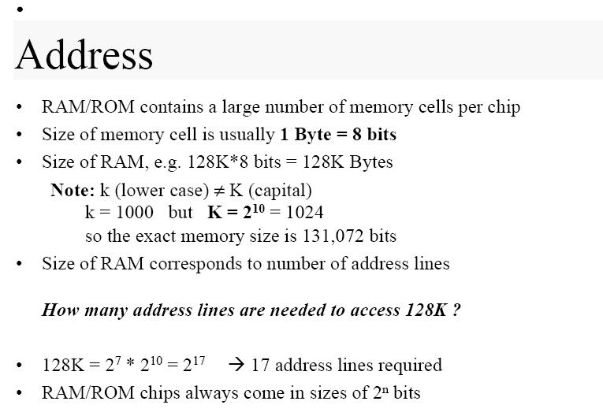

Slide 32
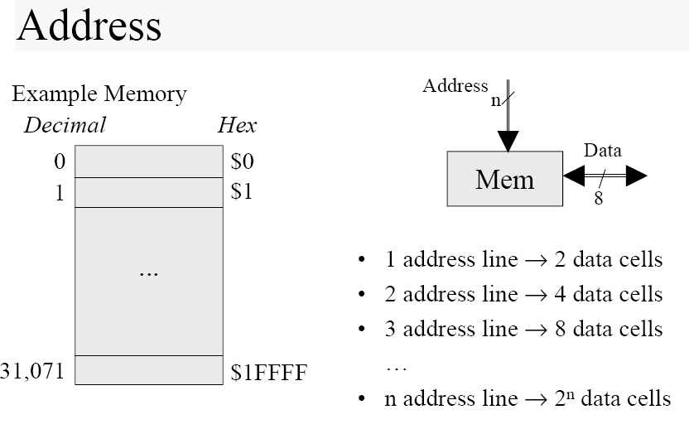

Slide 33
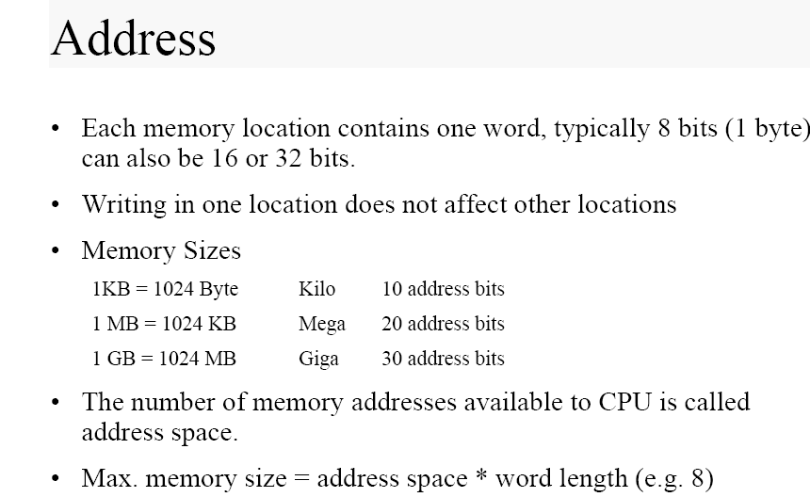

Slide 34
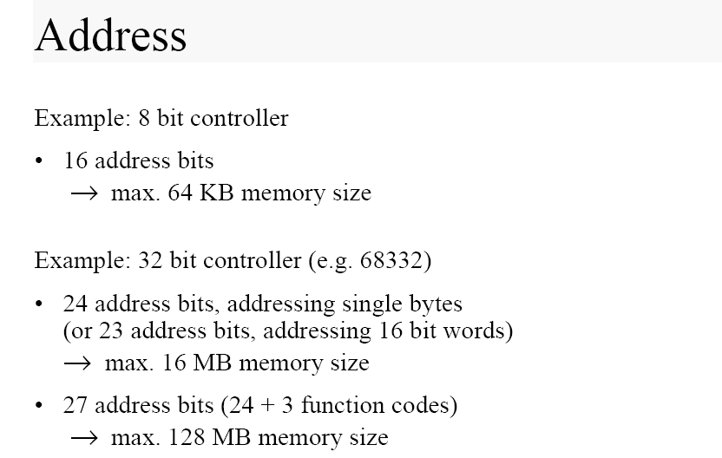

Slide 35
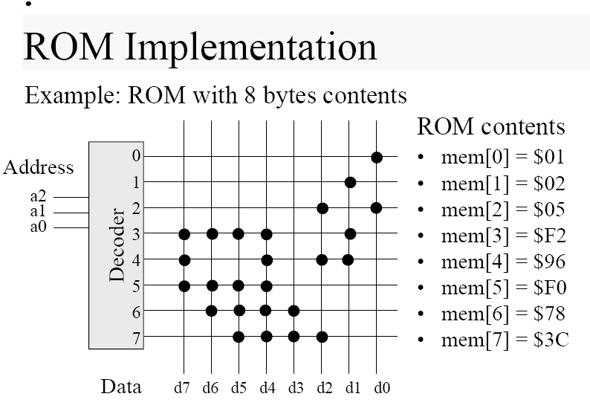

Slide 36
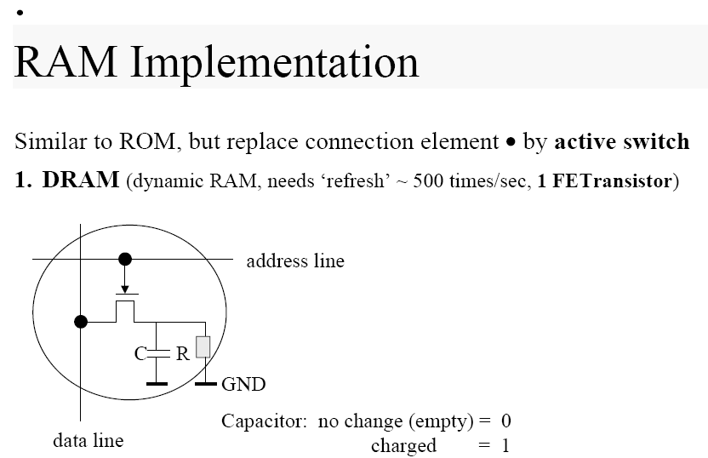

Slide 37
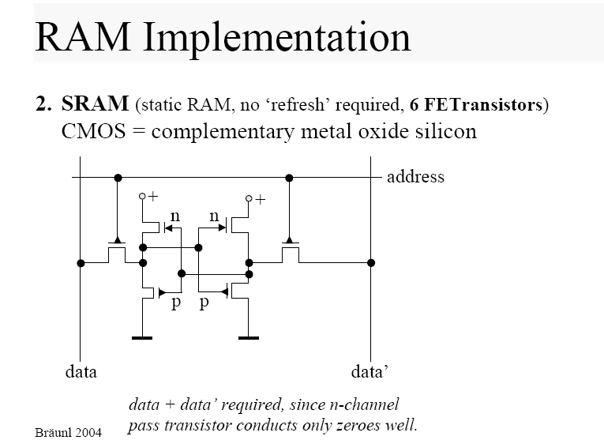

Slide 38
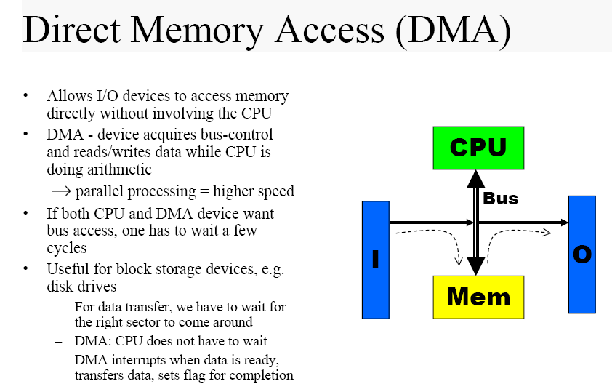

Slide 39
Schematic
Output device (screen)
Memory
CPU
program
Input device
(keyboard)
Sensors to measure physical values
Actuators to control physical things
bus
Permanent Memory
Need to know:
Digital Logic, Electrical Circuits, Computer Architecture

Slide 40
Timers, counters, watchdog timers
Timer: measures time intervals
To generate timed output events
e.g., hold traffic light green for 10 s
To measure input events
e.g., measure a car’s speed
Based on counting clock pulses
E.g., let Clk period be 10 ns
And we count 20,000 Clk pulses
Then 200 microseconds have passed
16-bit counter would count up to 65,535*10 ns = 655.35 microsec., resolution = 10 ns
Top: indicates top count reached, wrap-around
Basic timer
Clk
16-bit up counter
16
Cnt
Top
Reset

Slide 41
Counters
Counter: like a timer, but counts pulses on a general input signal rather than clock
e.g., count cars passing over a sensor
Can often configure device as either a timer or counter
Timer/counter
Clk
2x1 mux
16-bit up counter
Cnt
16
Cnt_in
Top
Reset
Mode

Slide 42
Watchdog timer
Must reset timer every X time unit, else timer generates a signal
Common use: detect failure, self-reset
Another use: timeouts
e.g., ATM machine
16-bit timer, 2 microsec. resolution
timereg value = 2*(2¹⁶-1)–X = 131070–X
For 2 min., X = 120,000 microsec.
osc
clk
overflow
overflow
to system reset
or
interrupt
prescaler
scalereg
timereg
checkreg
/* main.c */
main(){
wait until card inserted
call watchdog_reset_routine
while(transaction in progress){
if(button pressed){
perform corresponding action
call watchdog_reset_routine
}
/* if watchdog_reset_routine not called every < 2 minutes, interrupt_service_routine is called */
}
watchdog_reset_routine(){
/* checkreg is set so we can load value into timereg. Zero is loaded into scalereg and 11070 is loaded into timereg */
checkreg = 1
scalereg = 0
timereg = 11070
}
void interrupt_service_routine(){
eject card
reset screen
}

Slide 43
LCD controller
E
void WriteChar(char c){
RS = 1; /* indicate data being sent */
DATA_BUS = c; /* send data to LCD */
EnableLCD(45); /* toggle the LCD with appropriate delay */
}
communications bus
R/W
RS
DB7–DB0
microcontroller
8
LCD controller

Slide 44
Keypad controller
N1
N2
N3
k_pressed
N4
M1
M2
M3
M4
4
key_code
key_code
keypad controller
N=4, M=4

Slide 45
The Seven Segment Display
Counter
Display Controller
Clock
0000
0001
0010
0011
0100
…..

Slide 46
GPS Navigator
Complex system with many components
GPS Radio
GPS signal processor
Map database
Processor to control display and compute routes, locations, points of interest
Video image processor to control actual screen
May contain several different CPUs in one package

Slide 47
GPS Radio
Receives data from several satellites, converts RF to digital signals
Separate for each satellite
A set of at least 24 Medium Earth Orbit satellites that transmit precise microwave signals,
A GPS receiver can determine its location, speed, direction, and time.
Radio
receiver
circuitry
Signals (digital) from each satellite on separate wires

Slide 48
GPS signal processor
Correlates satellite signals
Computes timing differences
“triangulates” location
GPS data processor
Current location in latitude and longitude
Need to know:
Radio, Signal processing, Algorithms

Slide 49

GPS Navigator
The user interface – show location on map and provide useful other information
GPS Computer
Display Processor
MAP database
Touch Sensor
Need to know:
Computer Graphics, Graph Theory

Slide 50
Analog-to-digital converters
V_{max} = 7.5V
1111
4
4
7.0V
1110
6.5V
1101
3
3
6.0V
1100
5.5V
1011
2
2
5.0V
1010
analog input (V)
analog output (V)
4.5V
1001
1
1
4.0V
1000
3.5V
0111
3.0V
0110
t1
t2
t3
time
t1
t2
t3
t4
time
2.5V
0101
t4
2.0V
0100
0100
1000
0110
0101
0100
1000
0110
0101
1.5V
0011
Digital output
Digital input
1.0V
0010
0.5V
0001
0V
0000
proportionality
analog to digital
digital to analog

Slide 51
Digital-to-analog conversion using successive approximation
Given an analog input signal whose voltage should range from 0 to 15 volts, and an 8-bit digital encoding, calculate the correct encoding for 5 volts. Then trace the successive-approximation approach to find the correct encoding.
5/15 = d/(28-1)
d= 85
Encoding: 01010101
Successive-approximation method
½(V_{max} – V_{min}) = 7.5 volts
V_{max} = 7.5 volts.
0
0
0
0
0
0
0
0
½(5.63 + 4.69) = 5.16 volts
V_{max} = 5.16 volts.
0
1
0
1
0
0
0
0
½(7.5 + 0) = 3.75 volts
V_{min} = 3.75 volts.
0
1
0
0
0
0
0
0
½(5.16 + 4.69) = 4.93 volts
V_{min} = 4.93 volts.
0
1
0
1
0
1
0
0
½(7.5 + 3.75) = 5.63 volts
V_{max} = 5.63 volts
0
1
0
0
0
0
0
0
½(5.16 + 4.93) = 5.05 volts
V_{max} = 5.05 volts.
0
1
0
1
0
1
0
0
½(5.63 + 3.75) = 4.69 volts
V_{min} = 4.69 volts.
0
1
0
1
0
0
0
0
½(5.05 + 4.93) = 4.99 volts
0
1
0
1
0
1
0
1

